Slide 1


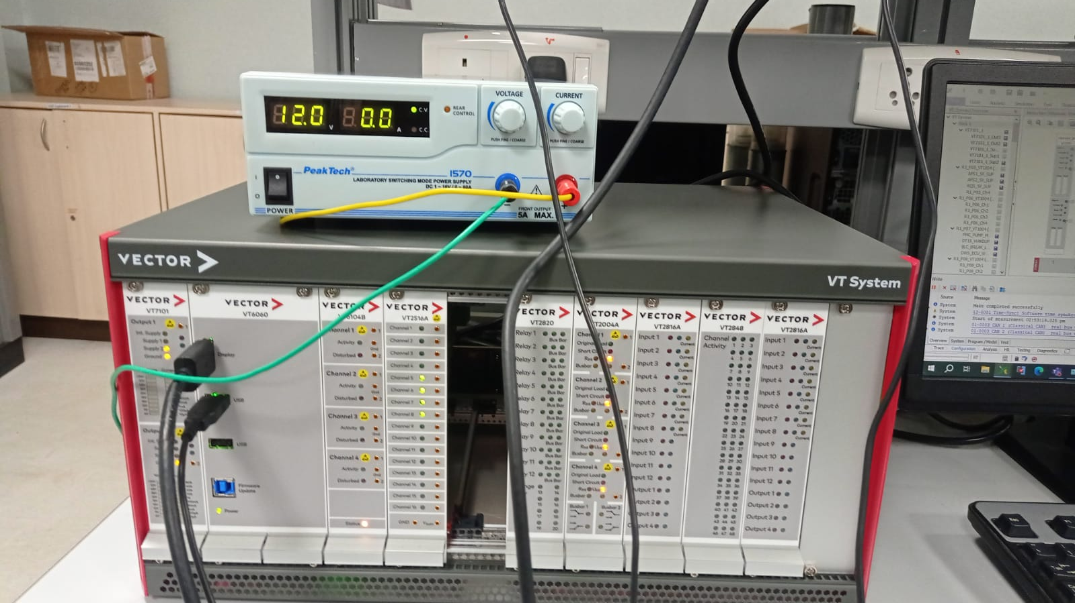
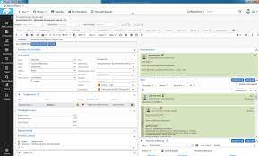
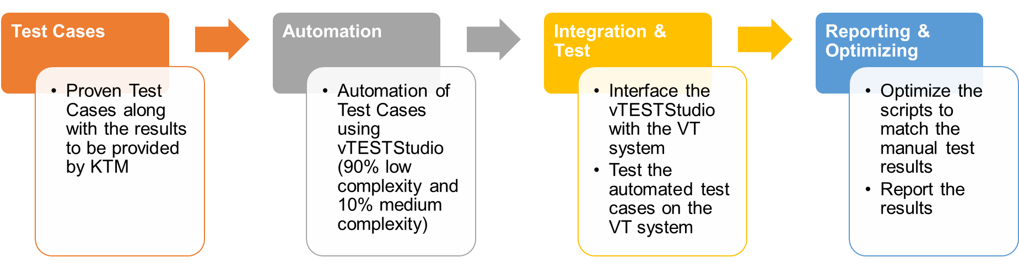
Demo 2: HiL Setup – Vehicle Controller for European OEM
Problem Statement: Create a remote test Lab to conduct validation of an Embedded RTOS based Vehicle Controller
Customer
Test Cases (172)
State Machine (25)
ECU states (11)
ASIL Functionality (29)
CAN Communication (22)
Failure Handling (72)
Default Values (9)
Voltage Range (4)
Tools Used:
Vtest Studio
CAPL/Python
CANoe
RestBus Simulation
TechM Value:
Created Lab with investments and resource
Commenced 7 system level tests within 5 weeks
Manual and Remote Testing
Customer

